Slide 1
Sports Nutrition Prepared By : Ms Saman Junaid For Semester V Date: 20th Sep 2020

Slide 2
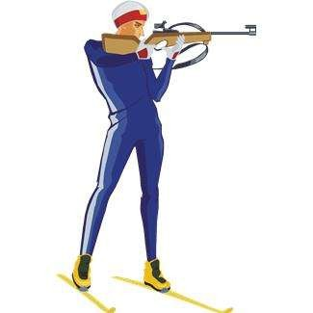
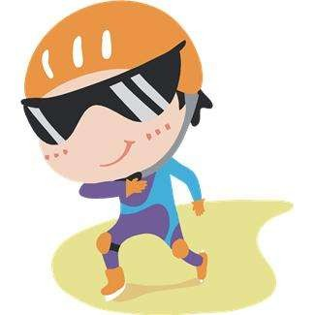
ROLE OF NUTRITION IN SPORTS

Slide 3
INTRODUCTION
Successful athletic performance is a combination of
proper training and a sensible approach to nutrition.
Sports nutrition is the study and practice of nutrition and diet as it relates to athletic performance. It is a science that provides and maintains food necessary for health, growth and physical performance
Researchers suggests that athletes can benefit from nutrition education – increasing KAP i.e. knowledge, Attitude and practices (Abood et al, 2006).

Slide 4
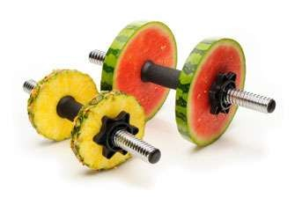
GOALS OF SPORTS NUTRITION
Optimal performance
Fast recovery and mental clarity
Injury prevention

Slide 5
CARBOHYDRATES
Carbohydrate provide energy for muscle
contraction-
smaller sugars
(glucose, fructose, galacto se) get absorbed and provide energy
Rest of the glucose is stored as glycogen in muscle and liver.
Adequate carbohydrate intake prevents proteins from being used as energy.
Carbohydrate depletion:
Recommendation- Athletes in heavy training should have an intake of 6-10g/kg body weight to prevent daily carbohydrate and glycogen depletion (ADA, 2000). The amount required depends on : Athletes TDEE, type of sports, environmental condition etc.

Slide 6
Before exercise- serves 2 purpose:
Keeps the athlete from feeling hungry before exercise
Maintains optimal level of blood glucose for exercising muscles (ACSM, 2009)
Should provide 200-350 gm of carbohydrate, 3-4 hrs
before the event.
Eg- toast with jelly, baked potato, spaghetti +tomato sauce, cereal with milk etc.
During exercise- For exercise lasting longer than an hour, carb intake ensures availability of sufficient amount of energy during later stages of exercise and improves performance, maintains blood glucose level too. Form of carb is not important, some may have sports drink.

Slide 7
Carb feeding doesn’t prevent fatigue, it delays it.
After Exercise- immediate carb consumption is important. Delaying carb intake for too long will reduce muscle glycogen synthesis.
Recommendation- consume 100g of carb within 30 minutes maximize glycogen synthesis.
Consuming food immediately after exercise seems difficult. Therefore, sports drink rich in carb provides energy and helps in rehydration.

Slide 8
PROTEINS
Protein requirements remain contradictory.
Popular belief that additional protein increases strength and
enhances performance, but research doesn’t support this.
Calories play an important role in protein sparing action and protein will be used if calories are insufficient.
Recommendations:
The average adult needs needs 0.8g/kg bw/d (Institute of Medicine, 2002)

Slide 9
FAT
Most concentrated source of energy.
Provides essential fatty acids- necessary for cell membranes, transport of fat soluble vitamins (ACSM, 2009)
Major fuel for light to moderate intensity exercise
Recommendations- athletes should consume 20-30% calories from fat.
1g fat = 9 kcal
High fat diets are associated with
CVD, obesity, diabetes etc, delays gastric emptying, takes longer to digest, lead to nausea.).

Slide 10
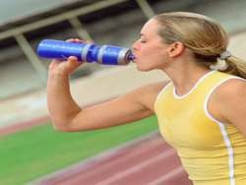
FLUIDS
Exercise and Sports
Increases physiological and psychological well being (Gianetti et al, 2008).
Water and electrolyte loss culminating in dehydration (Maughan and Shirreffs, 2010)
Depleted Psycho-physiological function (Danci et al, 2009; Kataria et al, 2010).

Slide 11
DEHYDRATION
HARMS
DEHYDRATION
PHYSIOLOGICAL FUNCTION
COGNITION
PSYCHO- PHYSIOLOGY
EXERCISE PERFORMANCE
INCREASE IN BODY TEMPERA TURE
INCREASED EXERTION
MEMORY
RISK OF INJURY
POOR ATTENTION
DNA DAMAGE
INCREASE HEART RATE
DECREASE REACTION TIME
PREMATURE FATIQUE

Slide 12
REHYDRATION
Sustaining cognitive and physical performance (Osteoberg, 2010).
Delay fatigue and thermal stress (Duvillard et al, 2004).
Prevent dehydration related injuries and improves recovery time (Rodriquez et al, 2009).
Therefore, fluid intake protocols have been recommended for athletes (ADA, 2000; SAI, ILSI & NIN, 2006; Lal, 2006).

Slide 13
HYDRATION GUILDELINES
Before
During exercise-
drink 250 ml of
fluid every 15-20 min
After exercise-
amount equivalent to body weight loss
exercise-
consume
500 ml of
fluid
1-2 hr before
exercise
(Position Statement ADA, 2000; SAI, ILSI and NIN, 2006; Lal,

Slide 14
STEPS FOR ADEQUATE HYDRATION
Be aware of sweat loss
1 kg water loss after exercise = 1 liter of water loss
Develop a conscious drinking pattern
What to drink
When to drink
How much to drink
Before activity – plain cold water/ glucose- electrolyte drink
During activity- glucose- electrolyte drink/ juice
After activity- glucose- electrolyte drink juice continue till urine is pale,
1gm wt loss= 1 ml of water
Coconut water, sugarcane juice, sports drink are also consumed.

Slide 15
VITAMINS
Play imp role in metabolic pathways- protein and bone synthesis, hemoglobin synthesis, and immune function. It has been assumed that if increased energy needs are met, vitamin and mineral requirement would also be met.
Poor nutritional status- Athletes report poor nutritional status due to training and poor work schedules, rely on snacking resulting in nutrient deficiencies.

Slide 16
IRON
Iron is required for red blood cell production.
Iron is required for a healthy immune system Inadequate iron in the body can impair aerobic metabolism by decreasing the delivery of oxygen to tissues and reducing the capacity of muscles to use oxygen for the oxidative production of energy.
Athletes have a high risk of iron depletion for several reasons:
High requirements
Increased red blood cell mass means athletes have higher iron needs.
Increased losses- Iron is lost in the sweat. Athletes with high sweat losses have higher iron losses. Iron concentration of sweat during exercise ranges from
0.13 to 0.42mg/l

Slide 17
3. Dietary Issues- Iron intake is often sub-optimal in athletes restricted food intakes: o Eating poorly balanced diets.
A high reliance on snack and convenience foods and failure to consume regular meals reduce the athlete’s intake of iron.
Hard exercise results in an increase in the volume of plasma in the blood. This can dilute haemoglobin levels and incorrectly suggest that there is a problem with iron status. This condition is known as ‘sports anaemia’.
with
increase in plasma volume leading to hemodilution
Heavy training
decrease in serum ferritin and Hb

Slide 18
CALCIUM
Osteoporosis- major health concern
ACSM, 1997 identified Ca deficiency in female athletes- characterized by estrogen deficiency, disordered eating, athletic amenorrhea, loss of bone mass.
Athletic amenorrhea- female athletes who exercise strenuously stop menstruating (Warren and Stiehl, 1999).
Diet modification- more calcium, Vitamin D intake- i.e. calcium fortified fruit juices, soy milk and tofu, milk and products, sesame seeds etc.
Excessive exercise
osteop
orosis
Athletic amenorr hea
Energy drain
Female athletic triad
Disorded eating- anorexia nervosa, bulimia nrevosa
Hypothalmic dysfunction or excess cortisol level
Inhibit the release of gonadotropins
amenor rhea

Slide 19
B VITAMIN
Increased energy metabolism creates a need for more B vitamin (serves as a part of coenzyme involved in energy cycles).
No evidence that supplementing the well nourished athlete with B vitamin will increase performance (Keith, 1994).
Deficiency of Vitamin B12 could develop in vegetarian athletes after several years of strict vegan intake. Supplements are required for these.
supplementation of diet with either single or multivitamin preparations containing B-complex vitamins, vitamin C or E does not improve physical performance in athletes with a normal biochemical vitamin balance resulting from a well-balanced diet.

Slide 20
Antioxidant nutrients
Vitamin A, E and C, beta carotene- protects cell membrane from oxidative damage.
increases oxidative processes in muscle
Increased generation of lipid peroxidases and free radicals
Exercise
Endurance exercise increases oxygen utilization in muscles and heart . Most of it is utilized for oxidative phosphorylation and some of it results in generation of free radicals.
These vitamins neutralizes free radicals. These nutrients may have a role in enhancing recovery from exercise but there is no evidence that they improve performance.

Slide 21
OTHER CONSIDERATIONS
ALCOHOL-
Has a detrimental effect on athletic performance.
Many athletes incorrectly believe that alcohol contains carbohydrates, and will improve performance.
It is a poor source of carbohydrate, vitamins, electrolytes and minerals
It has no effect on physiological processes of exercise.
Light social drinking during the day does not influence athletic performance.

Slide 22
Thank you!

